Slide 1
EU Carbon Farming
– where are we going
Asger Strange Olesen
EU CRC Expert Group, independent member
25 June 2025

Slide 2
CRCF as part of a single MRV system
Carbon Farming Certification
GHG inventories
Scope-3 reporting
Common Agriculture Policy
Certificate of compliance
Comprehensive information on climate, biodiversity, and sustainability
Certified unit
Tradable credit
Union-wide registry
From 2028

Slide 3
















The EU Green Taxonomy and the emerging EU architecture
National GHG/Climate Reporting LULUCF
Fit for 55%
All managed land in a MS
IPCC Methodologies
MS models & tools
EU and UN targets
LULUCF
Regulation
Recast
Farm support
Designated FMUs or areas, e.g., protected habitat
Other MS models & tools?
Specific policy objectives
CAP
Methodologies?
Product Value Chain
EUDR
Specific FMUs depending on exact supply chains
IPCC Methodologies
Freedom of model and tool
GHG footprint of entity or product
CSRD/CSDDD
Green Claims
Financial value chain
FMUs owned or financed by financial sector
GHG-Protocol or similar methodologies
Service Provider Tools
Non-Financial
Reporting
Directive
NZ-AOA/AM etc.
If you place a product in the EU and
wish to appraise for sustainability
Sustainable
Finance Disclosure
Regulation
Carbon/ES Tradable Units
2040
Climate Target
VCU
Accounted and ”additional”, but not eligible in e.g. EU-ETS
Individual plots or FMUs
Standard specific methodologies
Service Provider Tools
June 30, 2025
EU-ETS
EU-ESR
VCMs
Carbon
Removal
Certificates
EU Green
Taxonomy

Slide 4

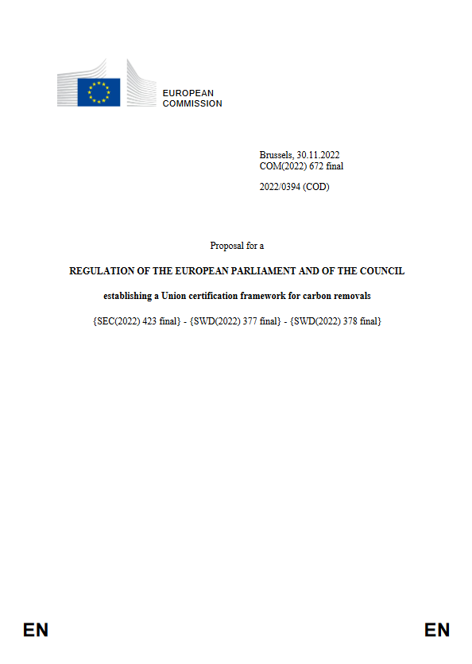
Main features of the upcoming EU CRC
Serial number for unique entry into registry operated by the European Commission from 2028
CRCs to be issued by the European Commission
Unique ID: XXX-ZZZ-YYY
Carbon Removal Certificate
For Forest Management Activity
within the European Union
verified to conform with the
CRC Framework and
resulting in
List of activities not settled. Afforestation and Forest Management foreseen.
CRCs can only be generated within the EU
The Certificate demonstrates conformity with the QUALITY criteria, by certification under approved scheme
Activity audited by certification body
Net removal | 10 t/CO₂
Here of additional removal equal to | 3 Certified units
Valid until | End of monitoring period
Verified tonnes of CO2eq net removed by the activity.
Certified units valid until removal is reversed or monitoring ends
Number of units of 1 tonnes CO₂ removed.

Slide 5
Next steps
2025
2024
Entry into force of CRCF Regulation - EU - 2024/3012 - EN - EUR-Lex
Proposal of first certification methodologies
Proposal of rules on verification and registries
2026
Recognition of certification schemes
2028
Start of EU registry
First issuance of certified units

Slide 6
More information:
DG CLIMA website on Carbon Removals and Carbon Farming
CRCF Regulation: Regulation - EU - 2024/3012 - EN - EUR-Lex
FAQ: a8abe1c4-a3c6-4c94-be0e-4b76f7fd0308_en (europa.eu)
EU carbon removals newsletter

